Slide 1
FY24 Budget Preliminary Presentation
April 19th, 2022

Slide 2
Fiscal Year 2024
Budget is based on a 5% increase in Common Area Fees (last increase FY17)
Revenue impact from $698,480 to $733, 404
Largest shift:
Staff Costs
Due to cost of living increase and maintenance O/T
Maintenance Costs
Maintenance hit hardest by inflation
Aging vehicle fleet
Marketing Expenditures
Cultural shift has required more Instagram, Facebook, photography, blog posts
This form of marketing is labor intensive which raises staff costs but is less expensive than more traditional forms of marketing (e.g. ad in Seven Days)
This also represents a more accurate capturing of expenses that were previously placed in this category

Slide 3
Staff Cost Breakdown
Name | Title | Percentage billed to CSM
Kara | Director | 20%
Samantha | Assistant Director, Downtown Projects and Programs | 50%
Julia | Marketing Manager | 50%
Jahna | Marketing Specialist | 50%
Andrew | Project & Event Coordinator | 50%
Steph | Admin. & Outreach Assistant | 50%
Jed | Church St. Marketplace Coordinator | 100%
Jim | Supervisor of Maintenance | 100%
Bruce | Marketplace Maintenance Worker | 100%
Gabe | Marketplace Maintenance Worker | 100%

Slide 4
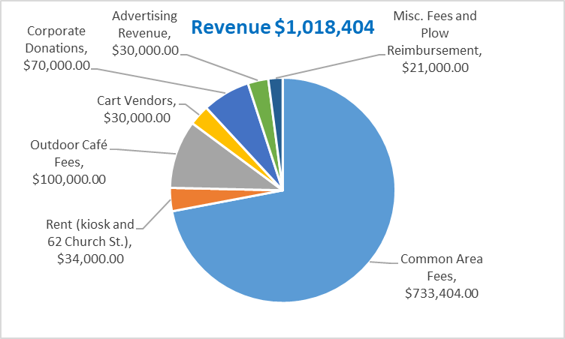
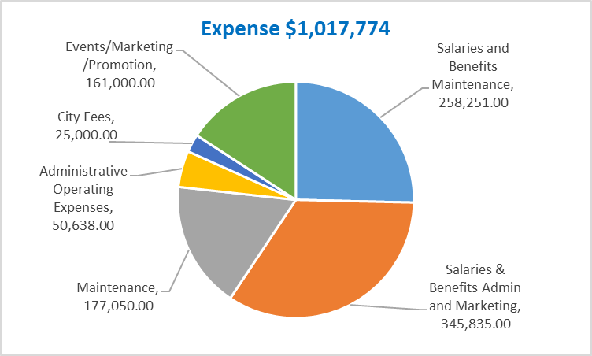
Revenue & Expense Comparison

Slide 5
Expense Comparison FY23 vs. FY24

